Slide 1

CAMPPANG
5조 문정우 박재희 옥다애 윤유나

Slide 2
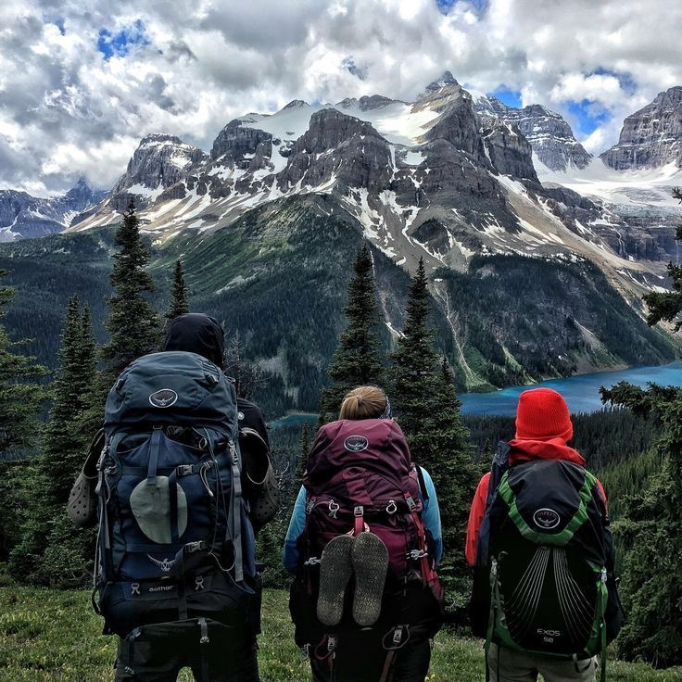
The secret of getting ahead is getting started. The secret of getting started is breaking your complex overwhelming tasks into small manageable tasks, and then starting on the first one.

Slide 3
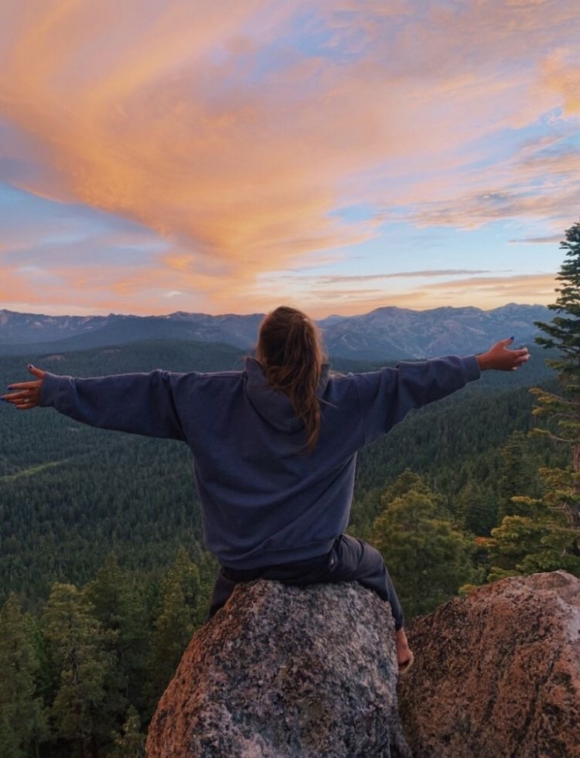
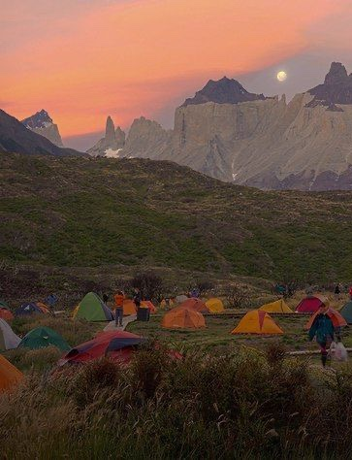
Always let your conscience be your guide.
Invariably they proclaim it can’t be done. I deem that the very best time to make the effort.
I have found it advisable not to give too much heed to what people say when I am trying to accomplish something of consequence.

Slide 4


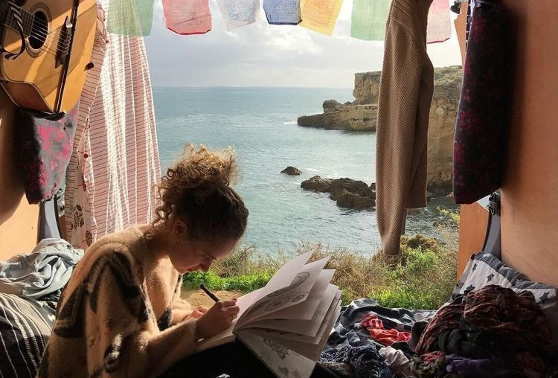
Even miracles take a little time.
I am trying to accomplish something of consequence. Invariably they proclaim it can’t be done.
If you keep on believing the dreams that you wish will come true.

Slide 5
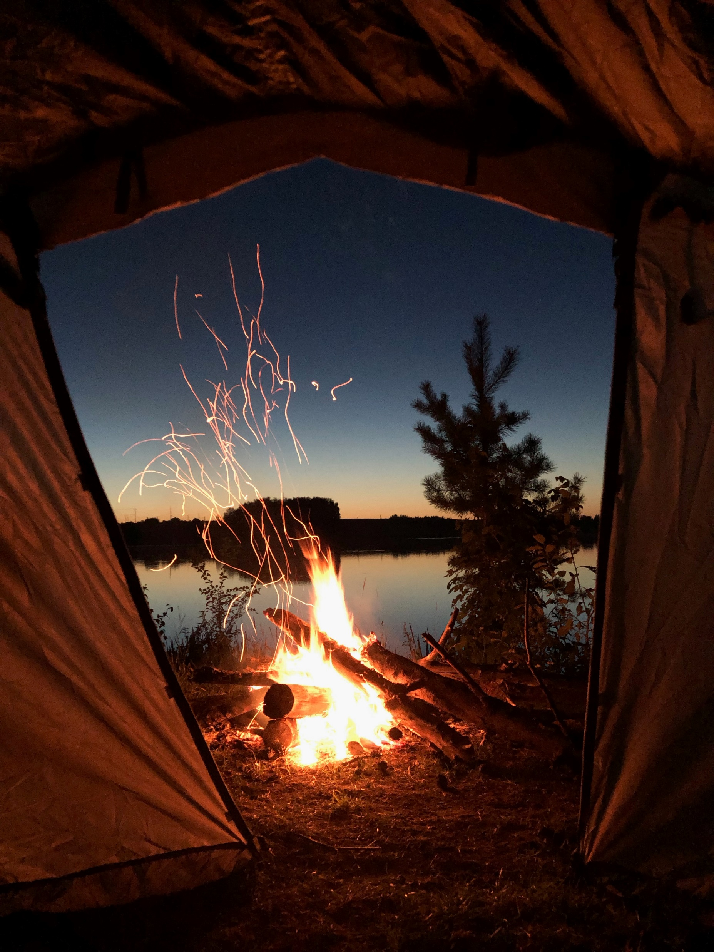

The person who makes a success of living is the one who see his goal steadily and aims for it unswervingly. That is dedication.

Slide 6

Hope is necessary in every condition.
Being to use the two most powerful words, I am, to your advantage, how about. I am receiving every good thing. I am happy. I am abundant. I am healthy. I am loved. I am always on time. I am eternal youth. I am filled with energy every single day.

Slide 7

It’s up to you how far you will go. If you don’t try, you will never know.

Slide 8

We all live on a network of stories
If you can concentrate always on the present, you will be a happy man. Happiness is the art of never holding in your mind the memory of any unpleasant thing that has passed.
85%
Forgive yourself for not knowing what you didn’t know until you lived through it

Slide 9
Techniques
Home
Information
Tools
Foods
Map
Good or bad past or present they all made you the person that you are today.

Slide 10
Contents
Day 01
Day 02
Day 03
Day 04
We must keep putting one foot in front of the other even when we hurt, for we will never know what is waiting for us just around the bend.
Forgive yourself for not knowing what you didn’t know until you lived through it
You fall, you rise, you make mistakes, you live, you learn. You are human, not perfect.
You’ve been hurt, but you’re alive. Think of what a precious privilege it is to be alive- to breathe, to think, to enjoy, and to chase the things you love.

Slide 11
Contents
Good or bad past or present they all made you the person that you are today.
Do what you love. Enjoy life. And expect miracles.
Be polite when in authority and be silent when in anger. This is called the life management.

Slide 12
Home
STEP 1
페이지 구성
STEP 2
Being to use the two most powerful words, I am, to your advantage, how about. I am receiving every good thing. I am happy. I am abundant. I am healthy. I am loved. I am always on time. I am eternal youth. I am filled with energy every single day.
STEP 3
STEP 4

Slide 13
I am filled with energy every single day.
Being to use the two most powerful words, I am, to your advantage, how about. I am receiving every good thing. I am happy. I am abundant. I am healthy. I am loved. I am always on time. I am eternal youth. I am filled with energy every single day.

Slide 14
Information
STEP 1
반응형 웹페이지
STEP 2
Being to use the two most powerful words, I am, to your advantage, how about. I am receiving every good thing. I am happy. I am abundant. I am healthy. I am loved. I am always on time. I am eternal youth. I am filled with energy every single day.
STEP 3
STEP 4

Slide 15
I am filled with energy every single day.
Being to use the two most powerful words, I am, to your advantage, how about. I am receiving every good thing. I am happy. I am abundant. I am healthy. I am loved. I am always on time. I am eternal youth. I am filled with energy every single day.

Slide 16
Tools & Foods
STEP 1
페이지 내 버튼 작동 및 기능 설명
STEP 2
Being to use the two most powerful words, I am, to your advantage, how about. I am receiving every good thing. I am happy. I am abundant. I am healthy. I am loved. I am always on time. I am eternal youth. I am filled with energy every single day.
STEP 3
STEP 4

Slide 17
I am filled with energy every single day.
Being to use the two most powerful words, I am, to your advantage, how about. I am receiving every good thing. I am happy. I am abundant. I am healthy. I am loved. I am always on time. I am eternal youth. I am filled with energy every single day.

Slide 18
Map
STEP 1
그 외(API 등)
STEP 2
Being to use the two most powerful words, I am, to your advantage, how about. I am receiving every good thing. I am happy. I am abundant. I am healthy. I am loved. I am always on time. I am eternal youth. I am filled with energy every single day.
STEP 3
STEP 4

Slide 19
I am filled with energy every single day.
Being to use the two most powerful words, I am, to your advantage, how about. I am receiving every good thing. I am happy. I am abundant. I am healthy. I am loved. I am always on time. I am eternal youth. I am filled with energy every single day.

Slide 20
Everyday is a new beginning.
Be honest when in trouble and simple when in wealth. Be polite when in authority and be silent when in anger. This is called the life management.

Slide 21
Even miracles take a little time.
I am trying to accomplish something of consequence. Invariably they proclaim it can’t be done.
If you keep on believing the dreams that you wish will come true.

Slide 22
May you rise up today with the full assurance that God has your back. He is with you, for you, and actively working on your behalf. he does for you what you cannot do for yourself. May you do for him the one thing you can do: Trust him with your whole heart and embrace joy along the way. Grace and peace to your this day.

Slide 23
We all live on a network of stories
If you can concentrate always on the present, you will be a happy man. Happiness is the art of never holding in your mind the memory of any unpleasant thing that has passed.

Slide 24
THANK YOU ☺

